Slide 1
Can you really study science in a Catholic school?
Debunking the myth of Science and Religion being in conflict throughout history project.

Slide 2
Scientist or theologian?

Slide 3
“Beautiful is what we see. More beautiful is what we comprehend. Most beautiful is what we do not comprehend.”
Blessed Nicolas Steno - scientist
Discovered the fact, known as Steno’s Law, that in all crystals of the same mineral the angles are the same. He is Beatified!

Slide 4
“Why are we in this world? “What awaits us after this life, which, even when long, ends so soon? And how must we conduct ourselves to achieve the end for which we were created.”
Gregorio Ricci - mathematician
The Ricci curvature tensor Rµν and the Ricci scalar curvature R are named after him. These appear in Einstein’s equations for the gravitational field .

Slide 5
“physics proceeds by an autonomous method absolutely independent of any metaphysical opinion.”
“I believe with all my soul in the truths which God has revealed to us and that He has taught us through his Church.”
Pierre Duhem – scientist and philosopher
He is remembered for the his work in thermodynamics.

Slide 6
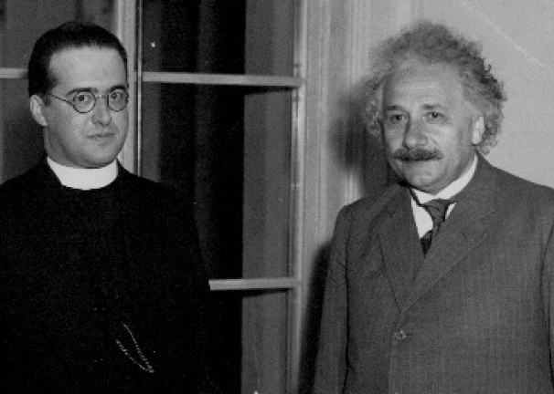
#bigbang
Pictured here is George LeMaitre and Albert Einstein. Both were men of science with significant contributions to our modern understanding of the universe, one of whom was a Catholic priest.

Slide 7
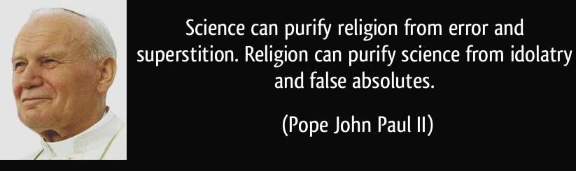
Scecina and Science!
As a Catholic school we are in the fortunate position to use the wonder and knowledge that God has given us to explore and further know the universe.
Like the priests and other men of faith mentioned, as well as countless others we must use the many gifts and talents we have been given to know God more deeply.
We can be inspired by Saint John Paul II

Slide 8
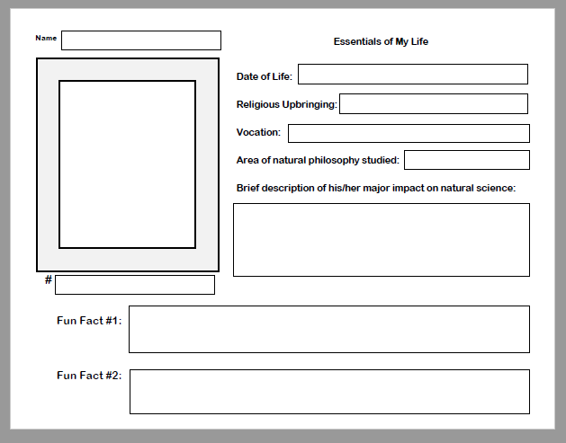
You will research a scientist with deep faith and create a trading card bio of him or her.
Fill in the information requested for the scientist you have been assigned. On the back of the card, turn your information into a paragraph.

